Slide 1
Memory Optimisation within
High-Level Synthesis
Muhammad Umer Hayat
Electronics Engineering · Hochschule Hamm-Lippstadt

Slide 2
Motivation
Memory access is often slower than computation.
Multiple operations may compete for the same memory bank.
Memory conflicts increase execution latency.
Adding more memory improves parallelism but increases hardware cost and area.
Memory optimization balances performance, latency, and hardware resources.
Notes:
Although arithmetic operations like addition and multiplication are very fast, the processor often has to wait for data to be fetched from memory. When multiple operations try to access the same memory bank at the same time, a memory conflict occurs, increasing the overall execution time. One solution is to add more memory banks so multiple accesses can happen in parallel, but this also increases hardware area, power consumption, and cost. Therefore, memory optimization aims to organize memory accesses efficiently, reducing conflicts while achieving the best balance between performance and hardware complexity.

Slide 3
High-Level Synthesis
Generic Architecture
› Translates a behavioural algorithm (e.g. C/MATLAB) into RTL hardware automatically.
Processing
Unit (PU)
› Performs scheduling, binding, and resource allocation.
Input
Output
›Traditional HLS mainly optimizes computation resources, while memory accesses are treated separately.
Memory
Unit (MU)
The designer must specify:
• Memory mapping
• Latency budget

Slide 4
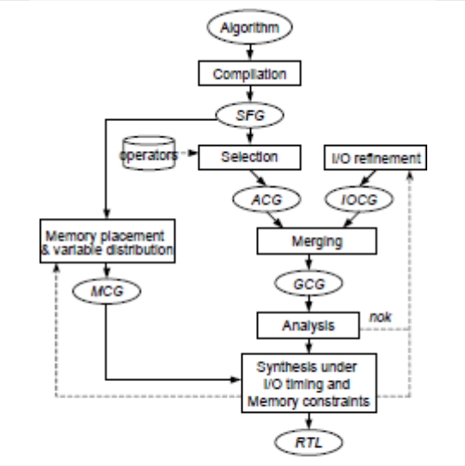
Design flow
Convert the input algorithm into a Signal Flow Graph (SFG)
Define memory mapping
Generate constraint graphs to represent timing and memory requirements
Schedule operations while avoiding memory access conflicts.
Generate final RTL architecture
Notes:
This design flow shows how the algorithm is gradually transformed into hardware. The important point is that memory constraints are not handled at the end. They are included during scheduling, so the final RTL already respects both timing and memory access limitations.

Slide 5
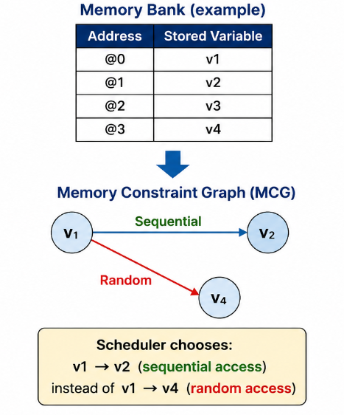
Memory Constraint Graph (MCG)
The MCG is constructed from the SFG and the memory mapping file.
Identifies valid and conflicting memory accesses.
Distinguishes sequential and random memory accesses.
Improves memory access efficiency using burst memory access.
The scheduler uses the MCG to prioritize sequential memory accesses and minimize conflicts.
Notes:
The Memory Constraint Graph is the main innovation introduced in this paper. After the variables are assigned to memory banks, the HLS tool builds an MCG that represents possible memory access patterns. It distinguishes between sequential accesses, which are faster, and random accesses, which are less efficient. During scheduling, if two operations compete for the same memory bank, the scheduler consults the MCG and selects the access pattern that minimizes conflicts and favors sequential memory accesses. This improves memory efficiency without increasing hardware complexity

Slide 6
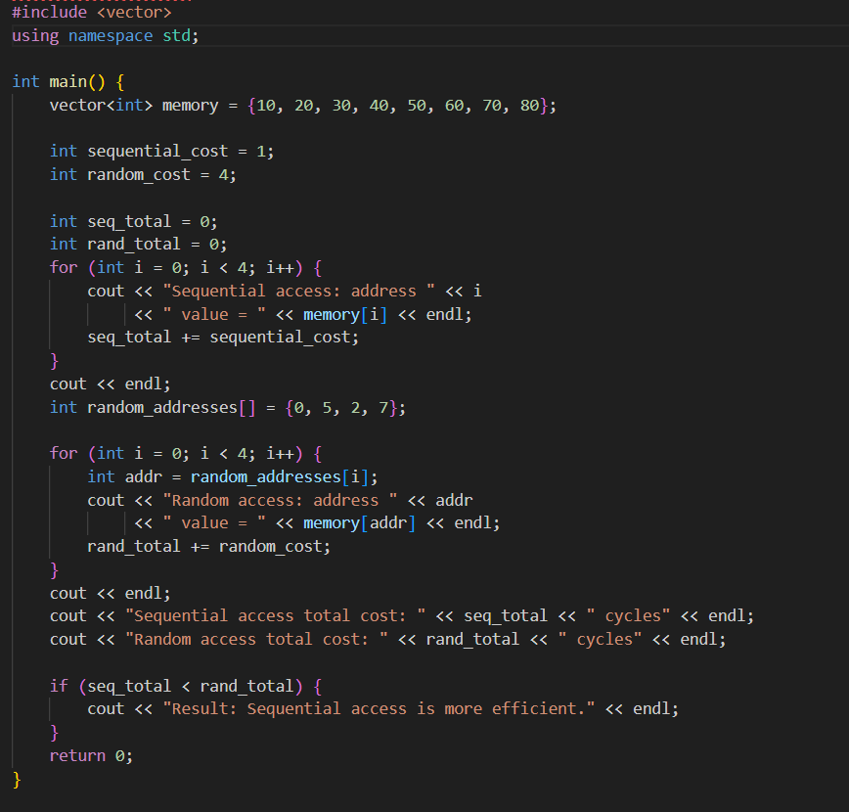
Sequential access total cost: 4 cycles
Random access total cost: 16 cycles
This shows sequential memory access in more efficient and uses fewer cycles.

Slide 7
Experiment: 128-Point FFT
200 MHz clock · Multiplier latency: 2 cycles · Add/Sub latency: 1 cycle ·
 | Mem. Banks | Input Buses | Out. Buses | Sub. | Add. | Mult. / Latency
Exp #1 I/O Timing only | 8 | 1 | 2 | 10 | 8 | 20 / 261 cycles
Exp #2 Memory only | 2 | 36 | 14 | 10 | 8 | 20 / 215 cycles
Exp #3 Both constraints | 2 | 1 | 1 | 10 | 8 | 17 / 343 cycles
Best trade-off: Experiment #3 satisfies both memory and I/O constraints using only two memory banks, at the cost of higher latency

Slide 8
Strengths & Limitations
Strengths
Limitations
Designer must manually adjust memory mapping when scheduling fails
Joint optimization of I/O and memory constraints
Formal models (ACG, IOCG, MCG, GCG) make constraints explicit and checkable
No heuristic guidance for which alternative to try when infeasible
Burst-mode scheduling reduces random memory access penalties
Memory model limited to single-cycle sequential.

Slide 9
Conclusion
› Memory access patterns and I/O timing cannot be optimised in isolation — they must be co-designed.
› The formal models (ACG, IOCG, MCG → GCG) provide a structured way to capture and analyse both constraint types.
› The scheduling algorithm prioritises burst-mode memory access while respecting I/O timing, reducing hardware cost.
› Optimizing memory access during HLS leads to simpler hardware and more efficient designs without relying on excessive memory resources.

